Slide 1
INTRODUCTION
democracyculturefoundation.org
Created & Edited by George Zochios

Slide 2
WHO WE ARE
Our Beliefs

Slide 3
DEMOCRACY
IS THE RULE OF LAW & THE RESPECT OF HUMAN RIGHTS
STANDS AT THE NEXUS OF CULTURE & IDENTITY
IS A PROCESS - NOT AN END PRODUCT.
AS SUCH, THE DESIGN & INTEGRITY OF THE PROCESS IS
CRITICALLY IMPORTANT

Slide 4
IN LIBERAL DEMOCRACY
THERE IS NO
ETHICAL RELATIVISM.
YOU EITHER HAVE
LIBERAL DEMOCRACY
OR YOU DO NOT.

Slide 5
WHO WE ARE
THE FOUNDATION

Slide 6
A Three-Year Old Foundation
STRUCTURE
Board of
Trustees
Leadership
Council
Board of
Governors
Operations
Team

Slide 7
A Three-Year Old Foundation
ORGANIZATION
Conferences
Projects
New Projects

Slide 8
Strategy
The Simple Impact Chain
THINK
TALK
DO
Ideas
Concepts
Content
People
Interaction
Projects
Advocacy
Lead To
Lead To

Slide 9
The Approach
Experts
Top - Down
Bottom - Up
People

Slide 10
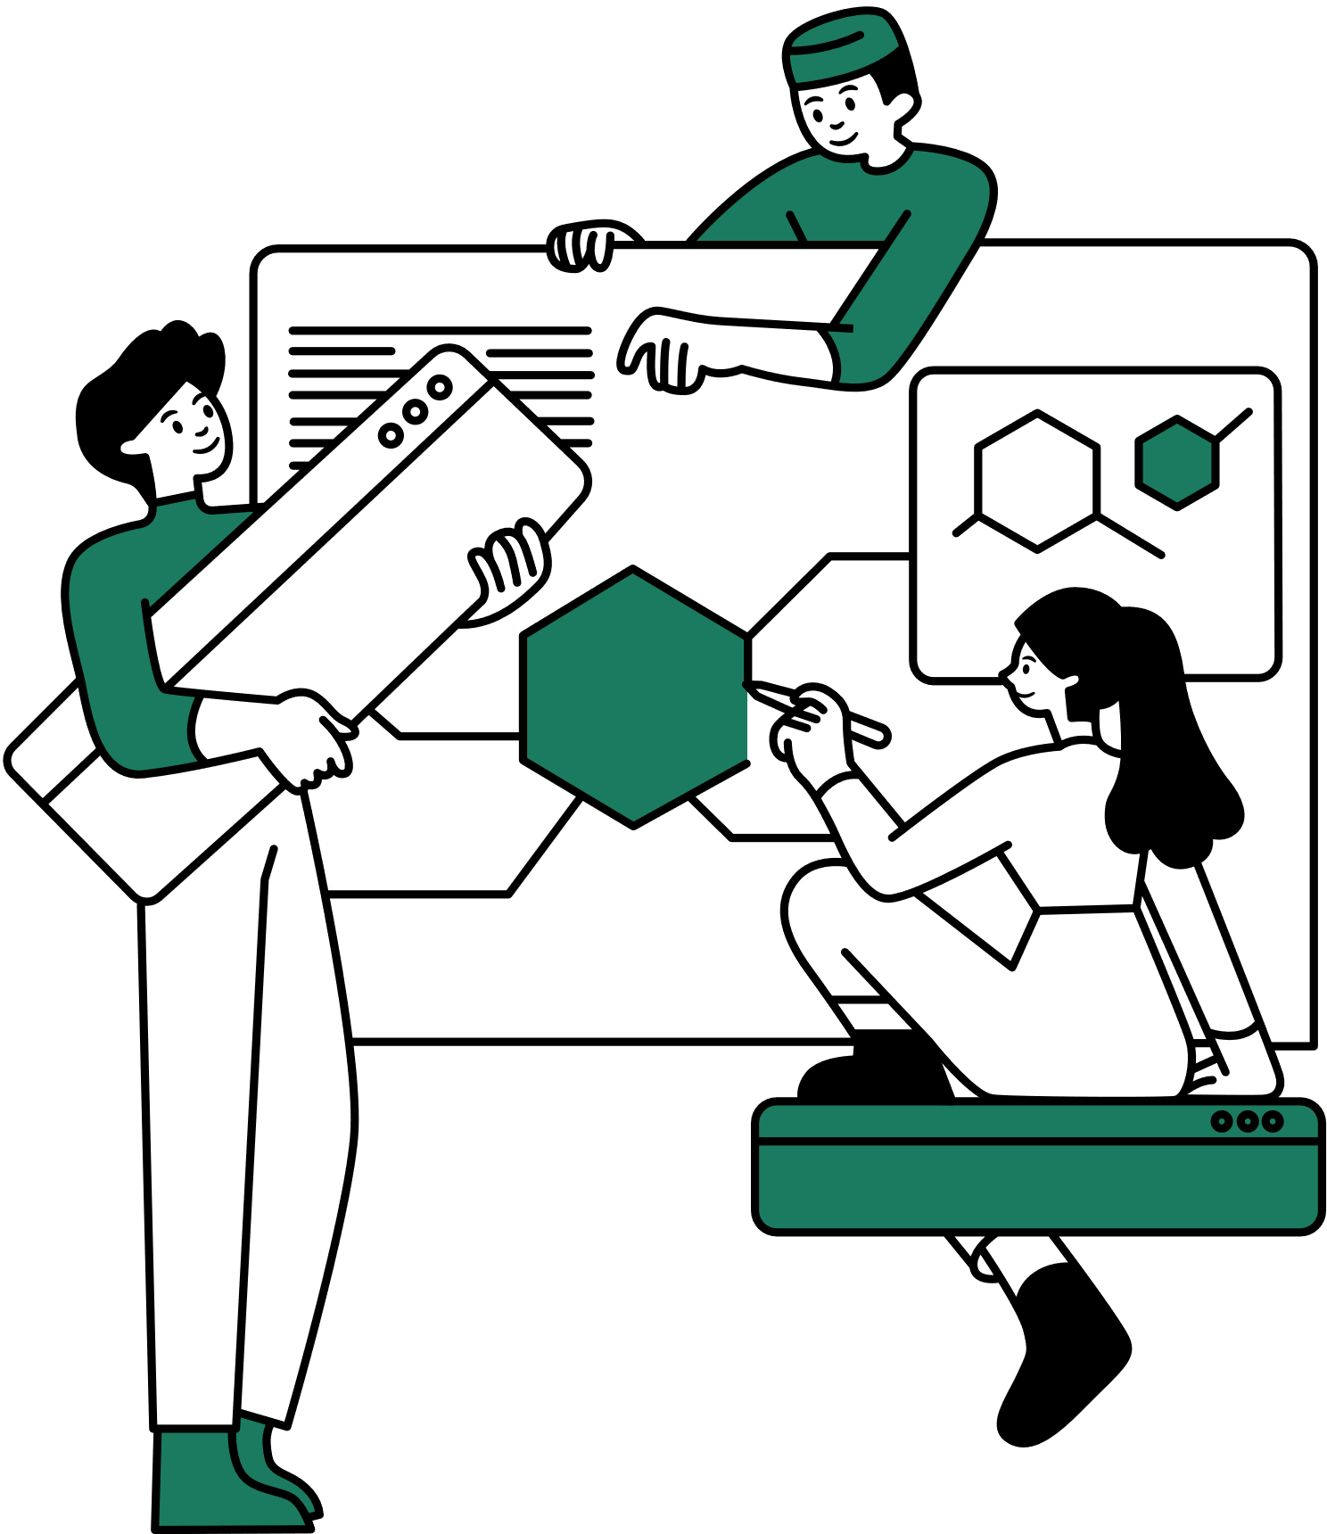
1
Democracy Catching Up
With Technology
Experts Roundtables
The Projects
Digital Tool Kit
Tools Of Deliberative
Democracy To Test Policy
2
3
Climate Hub - Regional Interactive Hub
Especially For Local Authorities

Slide 11
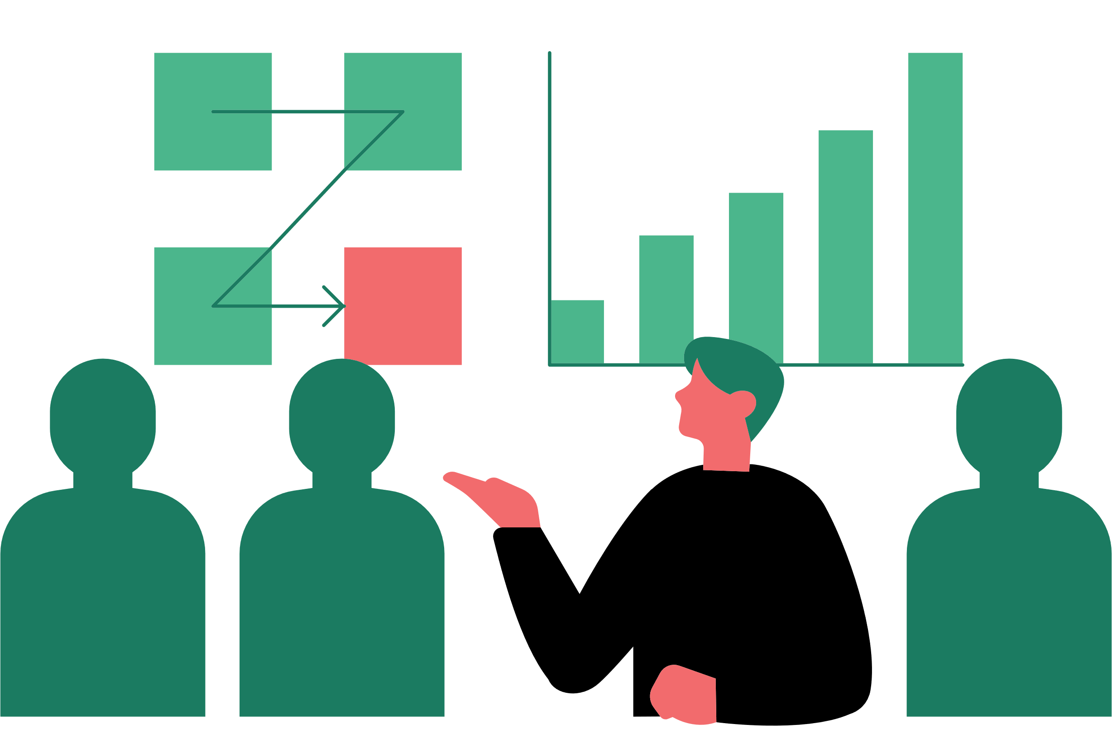
The Projects
Curated Library
Selected Articles, Books, Papers on Democracy
4
5
Re-Imagining The Building Blocks of Democracy
6
Teens ADF
Pilot To Develop a 3rd Conference
For Teens

Slide 12
The Projects
The Athenian Charter
A New Code Of Ethics For
Global Business
7
8
The Kofi Annan Foundation Prize For Democracy

Slide 13
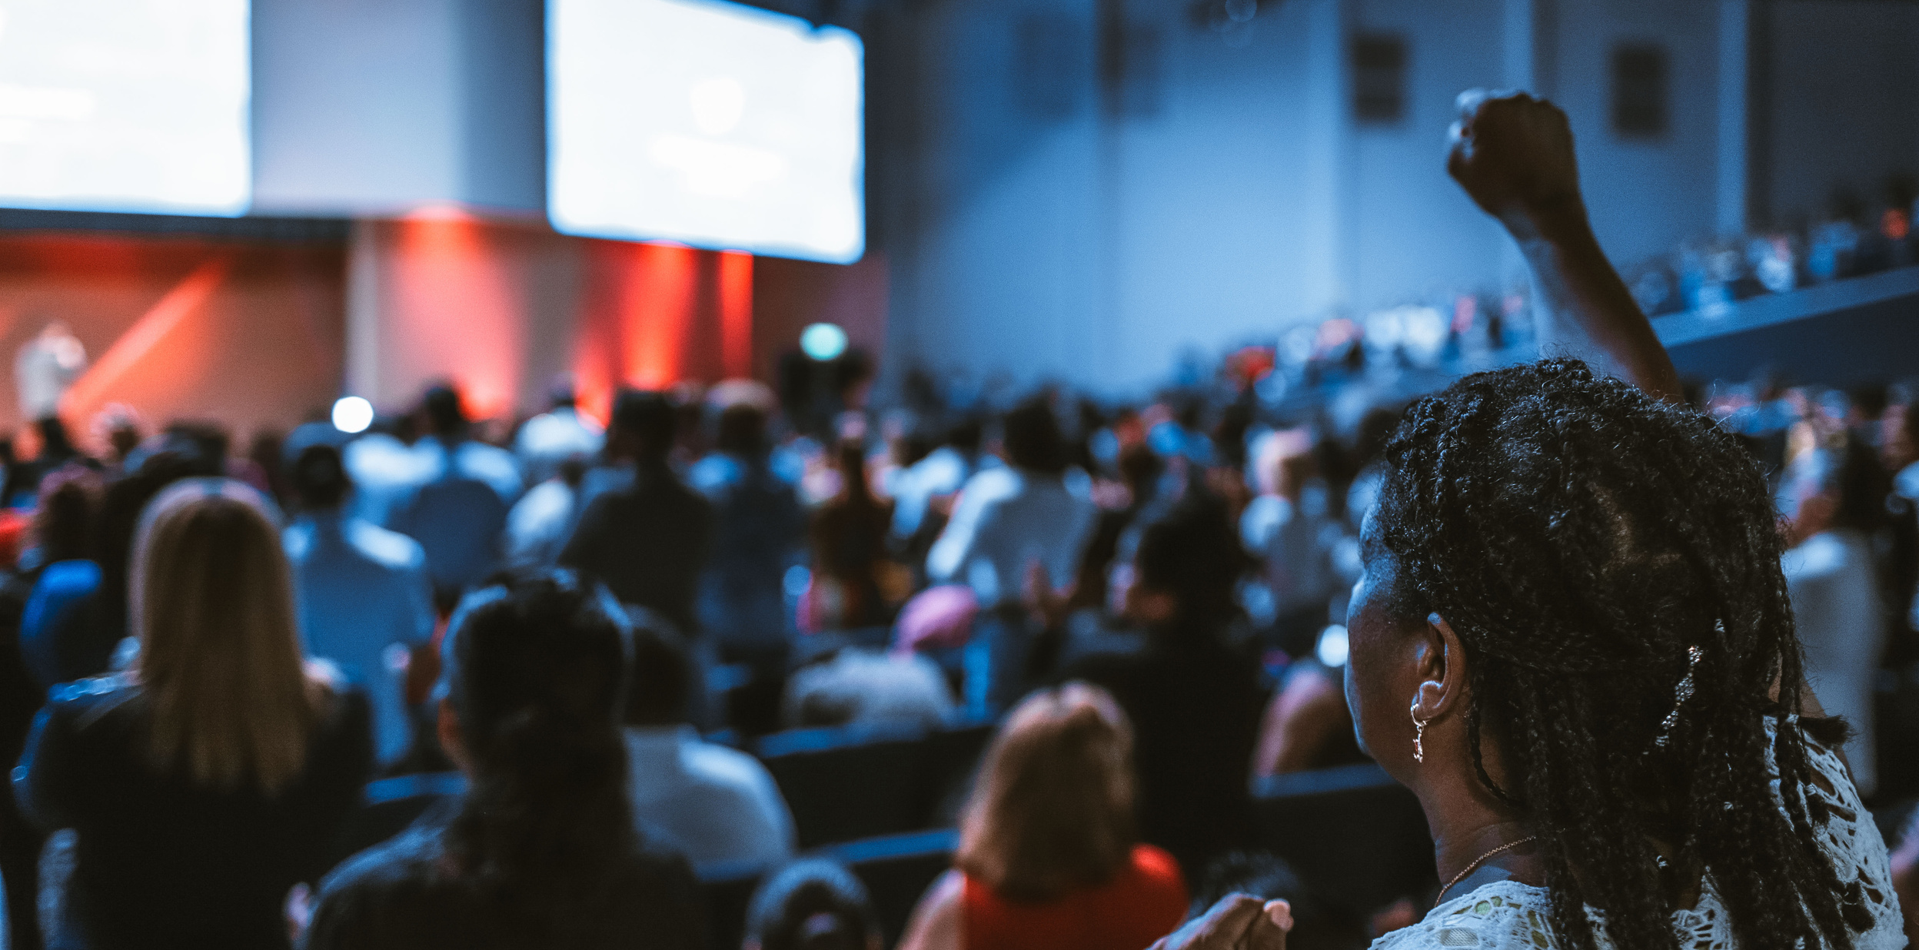
The Conferences

Slide 14
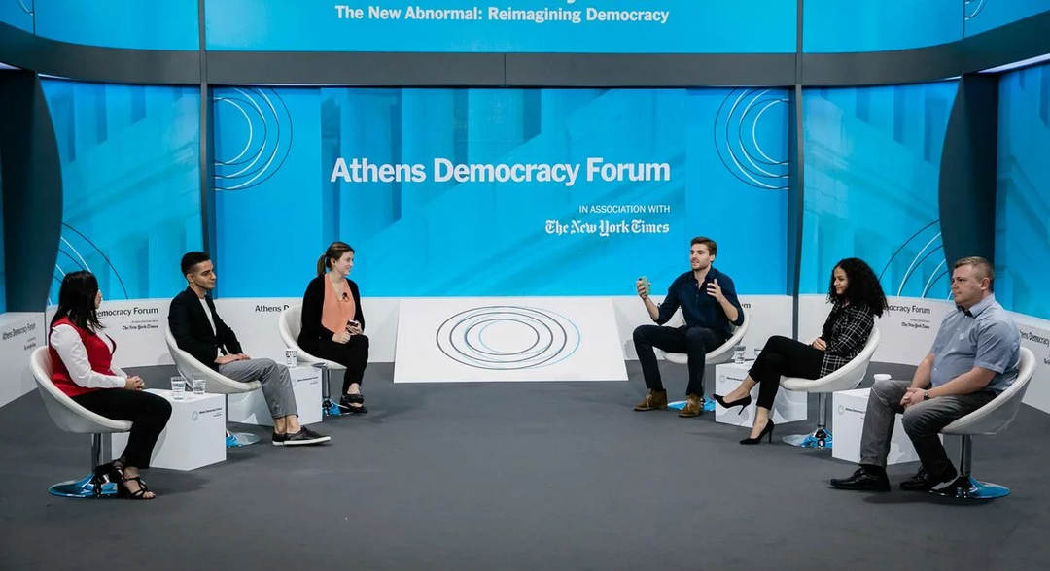
The Athens
Democracy Forum
A 2-day international conference
on current issues and ideas,
now in its 10th year,
run in association with the NYT.
Taking place in Athens.

Slide 15
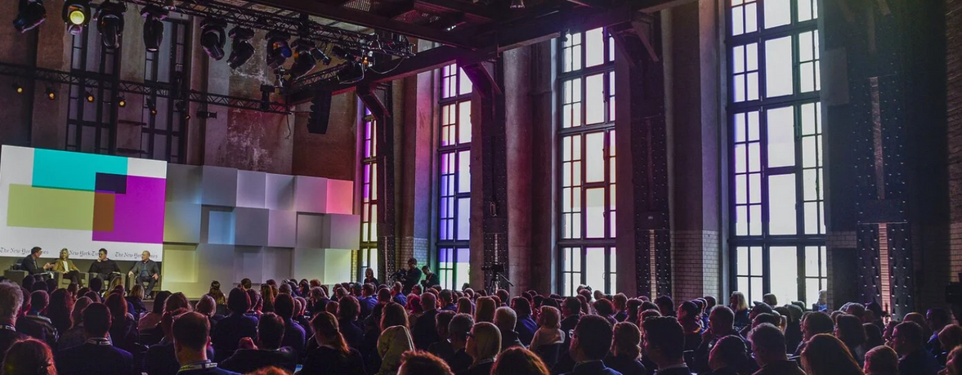
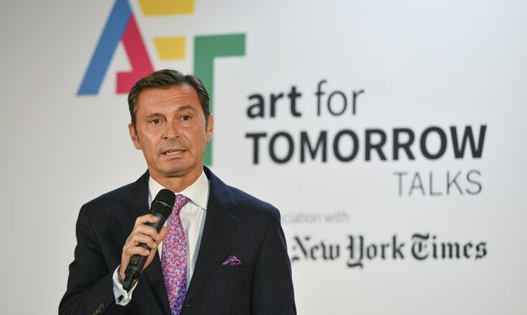
The Art for
Tomorrow Conference
A 2- & 1/2-days international conference on the relation between culture and democracy,
taking place in different European cities.

Slide 16
THE BUILDING
BLOCKS
An Introductory Tour

Slide 17
Re-Imagining the Building Blocks of Liberal Democracy
A 3-Year international project encompassing
the Global North & the Global South

Slide 18
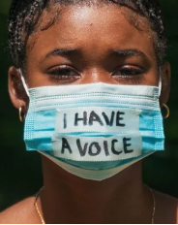
THE PROJECT'S
AIM
To reach practical policy recommendations that can
make liberal
democracy more resilient
to the dangers
of our Modern Times

Slide 19
The Partners - The Places
Tae Jae Academy
New Democracy Foundation
Bertelsmann Stiftung
Seoul
Sydney
Washington

Slide 20
The Partners - The Places
Konrad Adenauer Stiftung
Idea
Sapienship
Berlin
Tel Aviv

Slide 21
The Partners - The Places
Eidos Foundation
Microsoft
ENAfrica
Sekyra Foundation
Innovation For Development Foundation
Bucharest
Nairobi
Prague
Bogota

Slide 22
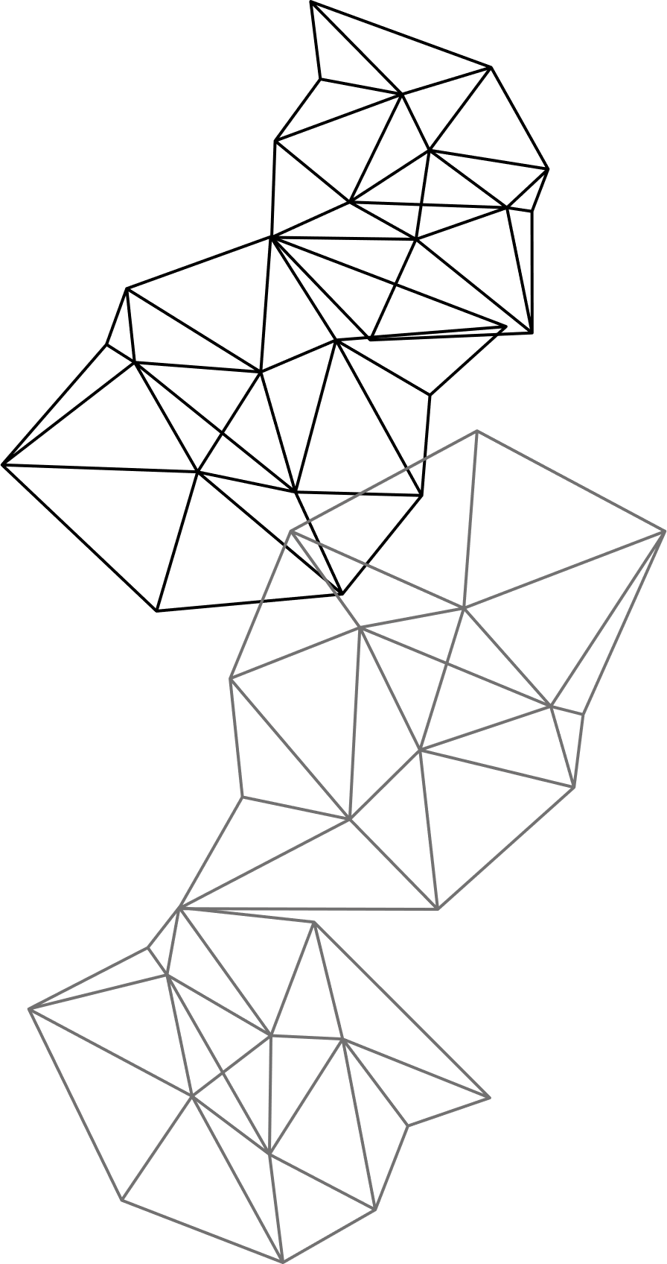
The Associates
ATLAS
McKinsey
The Berggruen Institue
Ban Ki Moon Foundation
Mo Ibrahim Foundation
Libra Group
ElectHer

Slide 23
HOW IT ALL STARTED
The Athens Democracy Forum as an incubator of
ideas and a space to talk

Slide 24
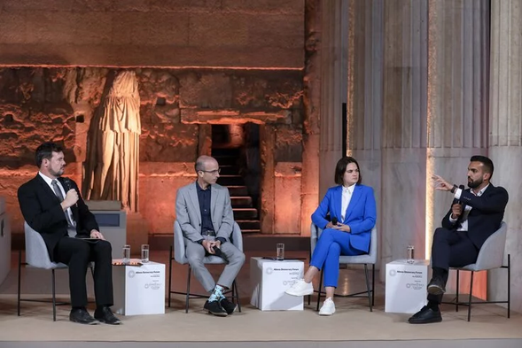
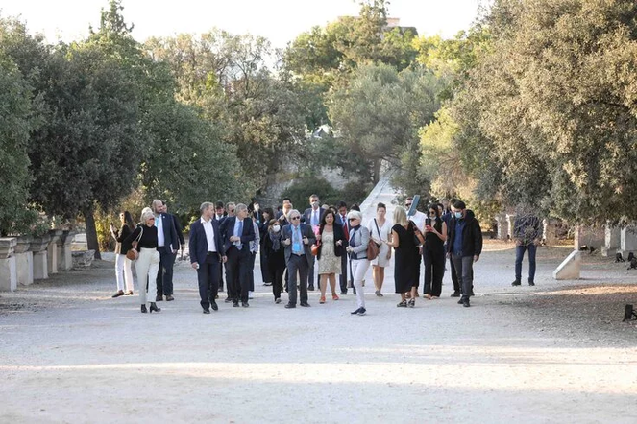
ATHENS
DEMOCRACY FORUM
SEPTEMBER 2021
All the talk was about the dangers faced by liberal democracies.
But..
Is Think and Talk enough?
What about doing something to meet these dangers?
What about DO?

Slide 25
FIRST STEPS
An Academic Committee to deal
with the following issues:
01
02
03
04
What is the meaning of "resiliency"?
Do we need theoretical or practical resiliency?
If theoretical,
is there enough time?
If practical,
at which function of liberal democracy should one intervene?
The operative word was "function"

Slide 26
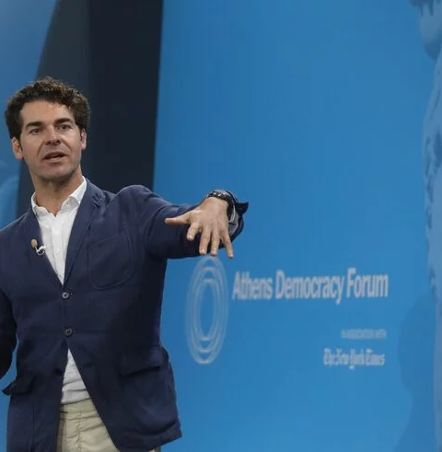
Critical Functions Prioritized
The people who participate - when and how
The voting - ability and legitimacy
The executive and the Legislature -
fight and balance
The parties - money and influence
The knowledge - information,
disinformation, truth and lies
The business world - an enemy
or a friend of democracy
Artificial Intelligence and Biotechnology -
the need for new ethics
FUNCTIONS

Slide 27
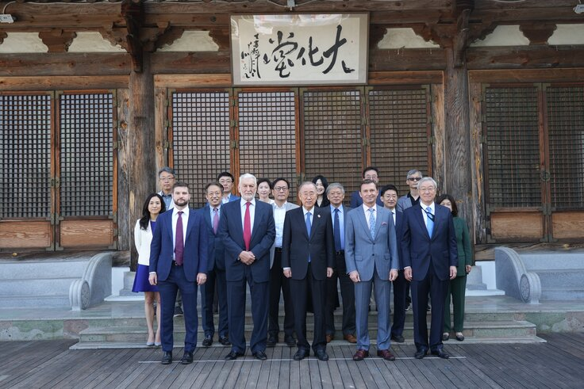
The Birth of the Building Blocks
& of the Process
The Power of the People
The Power of Voting
The Power of the Executive
The Power of Parties
The Power of Information

Slide 28
Implementing the project:
The Methodology
Approach
Aim
Top - Down
Bottom - Up
Talk
Recommend
Nature of recommendations
Diversity
Geographical
Social
Ethnocentric
Universal

Slide 29
Structure of the Project
DCF in association with a chosen partner / curator
A different partner / curator for each building block
Each partnership deals with one building block
Each partnership to reflect geographic and ethnic diversity
Each building block to be "examined" through 2 processes:
Top - Down
Bottom - Up

Slide 30
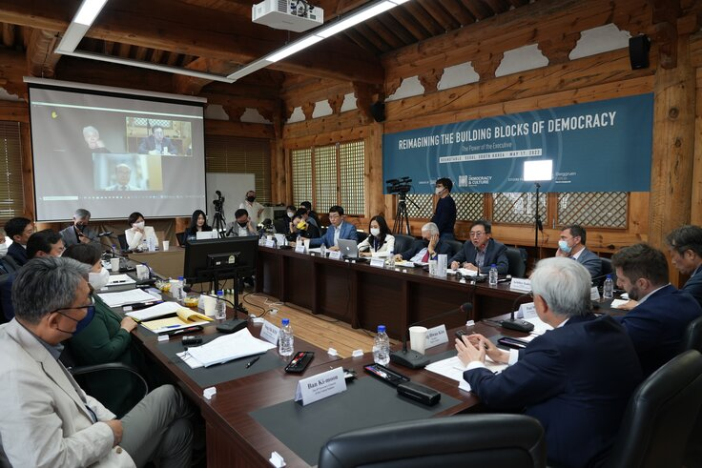
The structure of the Roundtables
3-5 experts to analyze and recommend
3-5 experts to rebut or embellish
A selected audience of 20 academicians,
politicians, civic society reps, business world
reps
Rapporteur appointed by partners
Recommendations to be stress-tested by
citizens' panels in ways chosen by curators:
Citizens' panels
Polls
On the spot
Subsequently

Slide 31
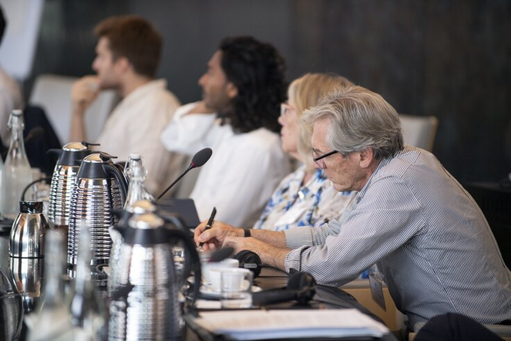
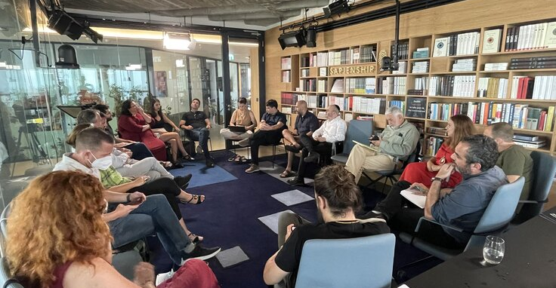
Structure of Consultation
Facilitators, panel of speakers, rapporteur
Audience of 70-100 physical presence
Equal number online
Local contacts and local press releases &
advertising ensure an audience composed by
a variety of citizens joined by their common
interest in the subject
A chosen panel introduces the subject -
questions by the audience, elucidations,
directions on process given by facilitators
Break up in groups - Café-style, discuss, recommend
Regroup - summarize recommendations

Slide 32
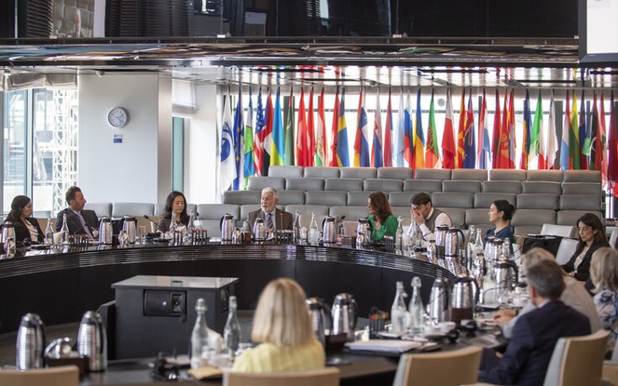
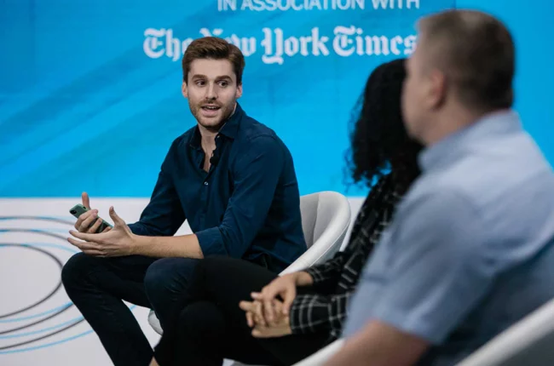
The London
Meetings
Year 1
All rapporteurs meet to:
Discuss recommendations
Ensure consistency
Year 2
All rapporteurs meet to:
Examine recommendations
Identify differences between those by the experts and those by the citizens
Finalize ADF presentation

Slide 33
Summary Overview
YEAR 1
Level
1
Level
2
Level
3
Recommendations
reached by experts'
roundtables
Recommendations
stress-tested by citizens' panels
Recommendations
tested by all curators/rapporteurs
ADF Presentation

Slide 34
Summary Overview
YEAR 2
Level
4a
Level
4b
Level
5
Recommendations
obtained from citizens' driven meetings
Deep dive at
level 3 recommendations
All recommendations tested
ADF Presentation

Slide 35
THE YEAR 1 POLICY RECOMMENDATIONS
An Overview

Slide 36
THE GRAVEST
DANGER
FOR
DEMOCRACY
THE BREAKDOWN
OF
TRUST

Slide 37
The Fears
The government has TOO MUCH POWER
The influence of money is TOO STRONG
Legislators have TOO LITTLE POWER
Citizens' input is TOO RESTRICTED
Technology will lead to SOCIAL & ECONOMIC DIVIDE

Slide 38
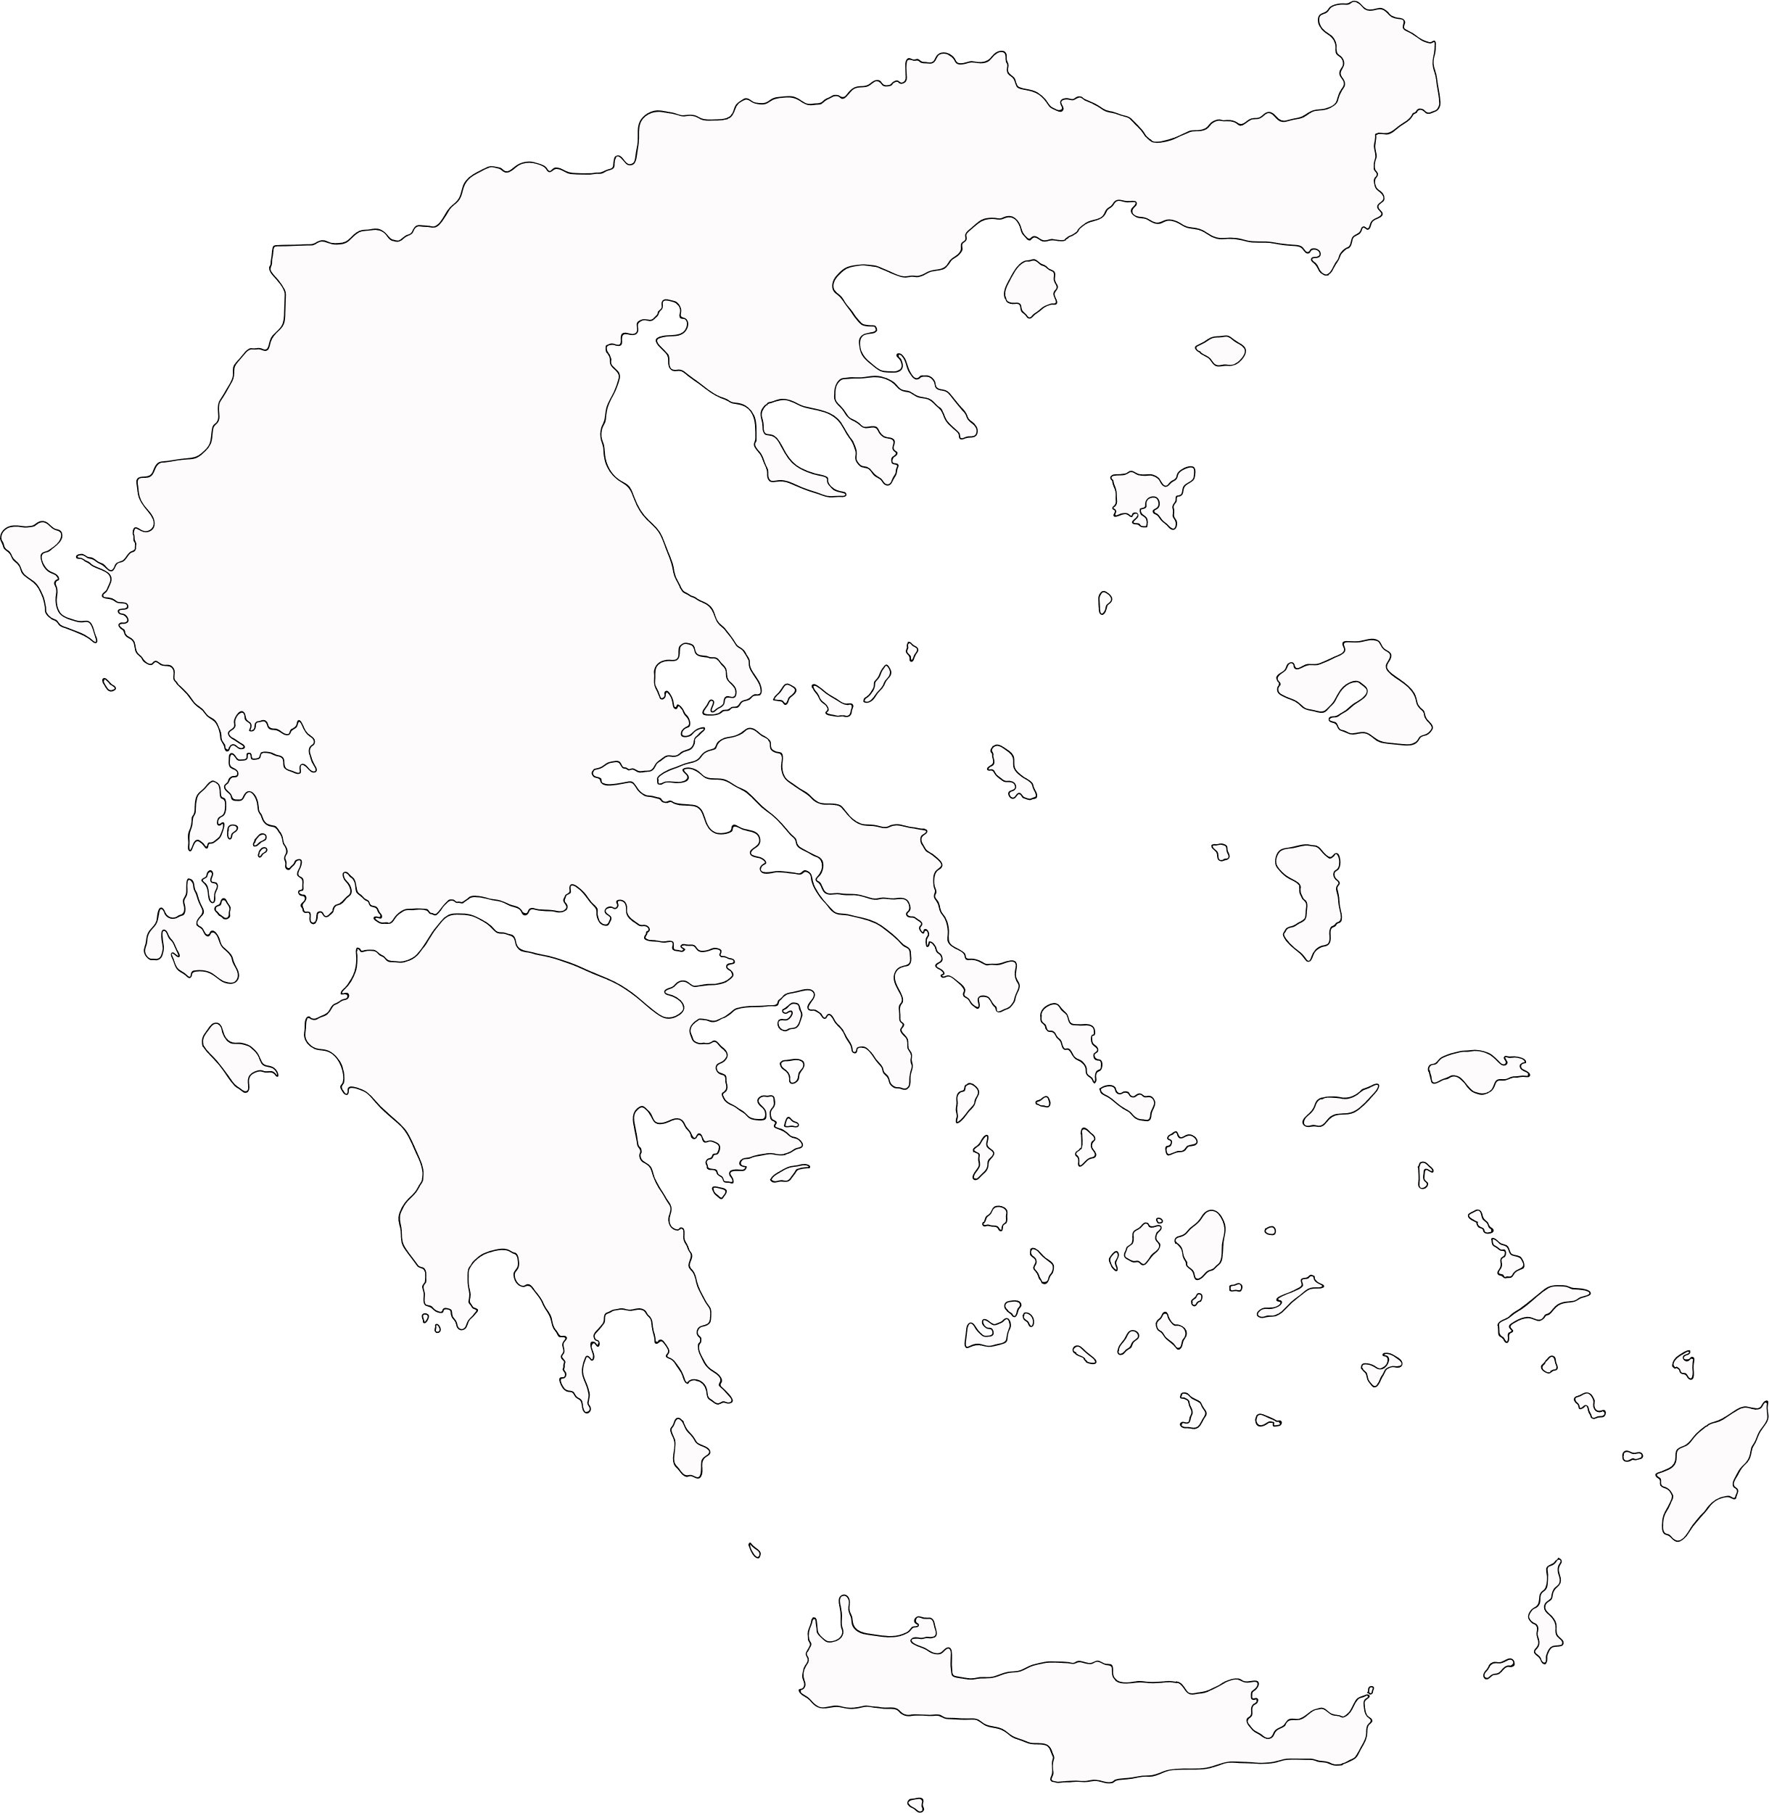
Main Answer
Citizen Engagement At All Levels
Local
Regional
National

Slide 39
THE RECOMMENDATIONS
Across all building blocks

Slide 40
POLICY RECOMMENDATION I
Parliamentary commities (or the equivalent) that are convened to discuss and/or amend government proposed (draft) laws must call for
citizens' assemblies to debate the laws and must take their recommendations into account.

Slide 41
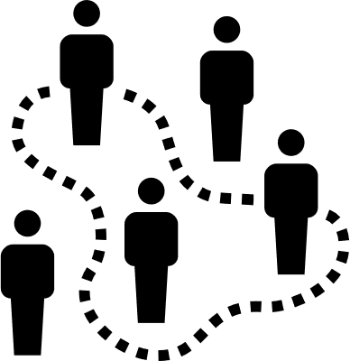
POLICY RECOMMENDATION II
Set up a fourth body of legislature composed of ordinary citizens chosen by sortition to serve alongside policy experts and deliberate issues locked in political stalemates or requiring additional review.

Slide 42
POLICY RECOMMENDATION III
Empower citizens' assemblies where citizens selected by lottery deliberate on important issues and make decisions binding on government.

Slide 43
POLICY RECOMMENDATION IV
Make citizens' assemblies compulsory (like jury service) and compulsory for legislature to host, attend & report.

Slide 44
POLICY RECOMMENDATION V
Select a citizens' assembly (comprised of citizens & experts) and task it to design a process for defining and labelling disinformation across search engines and social media accounts.

Slide 45
POLICY RECOMMENDATION VI
Make political parties more flexible in establishing different types of membership (part-time, full-time, supporting, executive)
each with a clear path of personal development within the party.

Slide 46
POLICY RECOMMENDATION VII
Allow party members to dip in & out of party politics as they choose, harnessing technology and making it easy and fun to participate.

Slide 47
AT THE
INSTITUTIONAL LEVEL I
Institutionalize an oversight or advancement of democracy body to deal with:
Polarization
Single-issue candidates
Extent of disenfranchisement

Slide 48
AT THE
INSTITUTIONAL LEVEL II
Enhance power of existing independent authorities.
Abolish single-member plurality systems for more proportional presentation.

Slide 49
AT THE
INSTITUTIONAL LEVEL III
Safeguard the intendance of the judiciary by establishing an independent judicial council for appointments and evaluations.

Slide 50
Thank you & we hope
you join us at ADF
this September,
in Athens

Slide 51
Created & Edited by George Zochios

